Slide 1



Accelerator-Aware In-Network Load Balancing for Improved Application Performance
Hesam Tajbakhsh, Ricardo Parizotto, Miguel Neves, Alberto Schaeffer-Filho, Israat Haque
IFIP Networking Conference 2022

Slide 2
Agenda
Context and motivation
Background and related work
P4Mite design
Implementation and evaluation
Conclusions

Slide 3
Context and Motivation

Slide 4
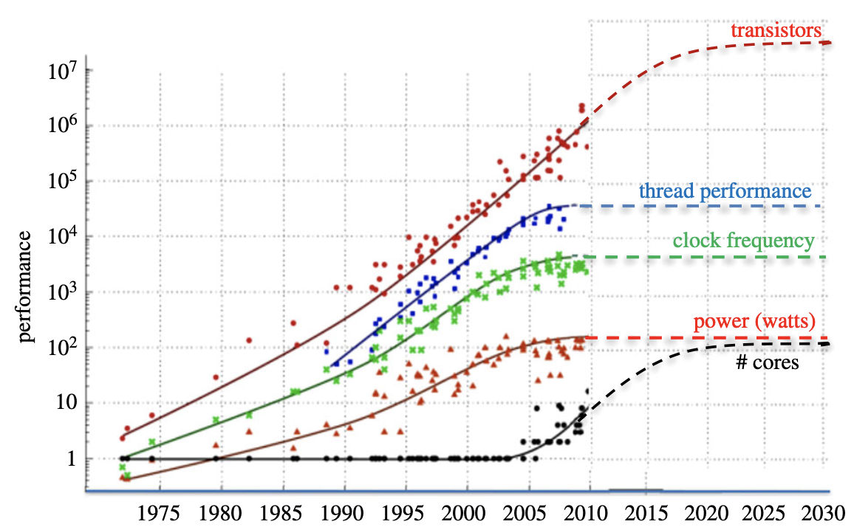
Moore’s law
Computer performance is reaching a plateau due to the end of Moore’s law.
IFIP Networking Conference 2022
Source: https://tinyurl.com/5xtpd2m5

Slide 5
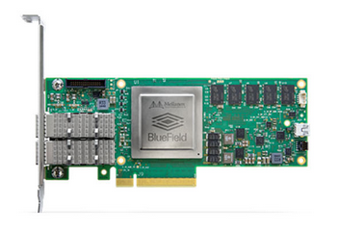
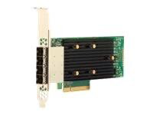
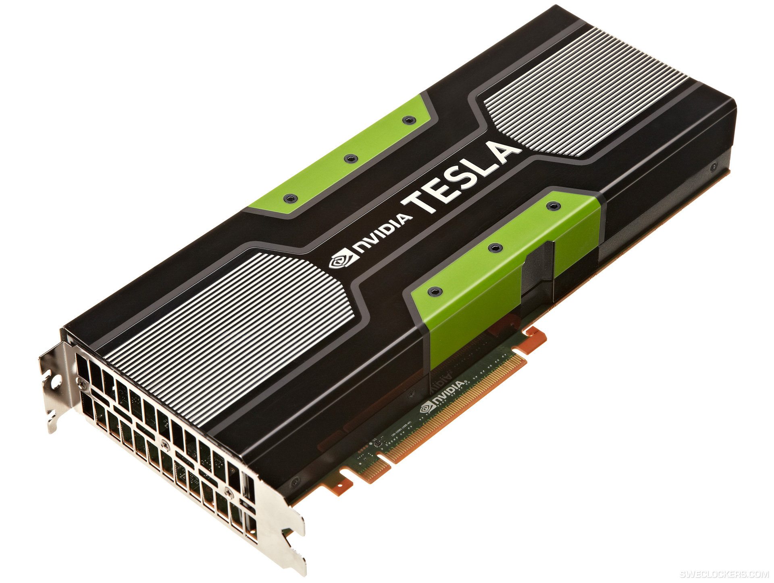
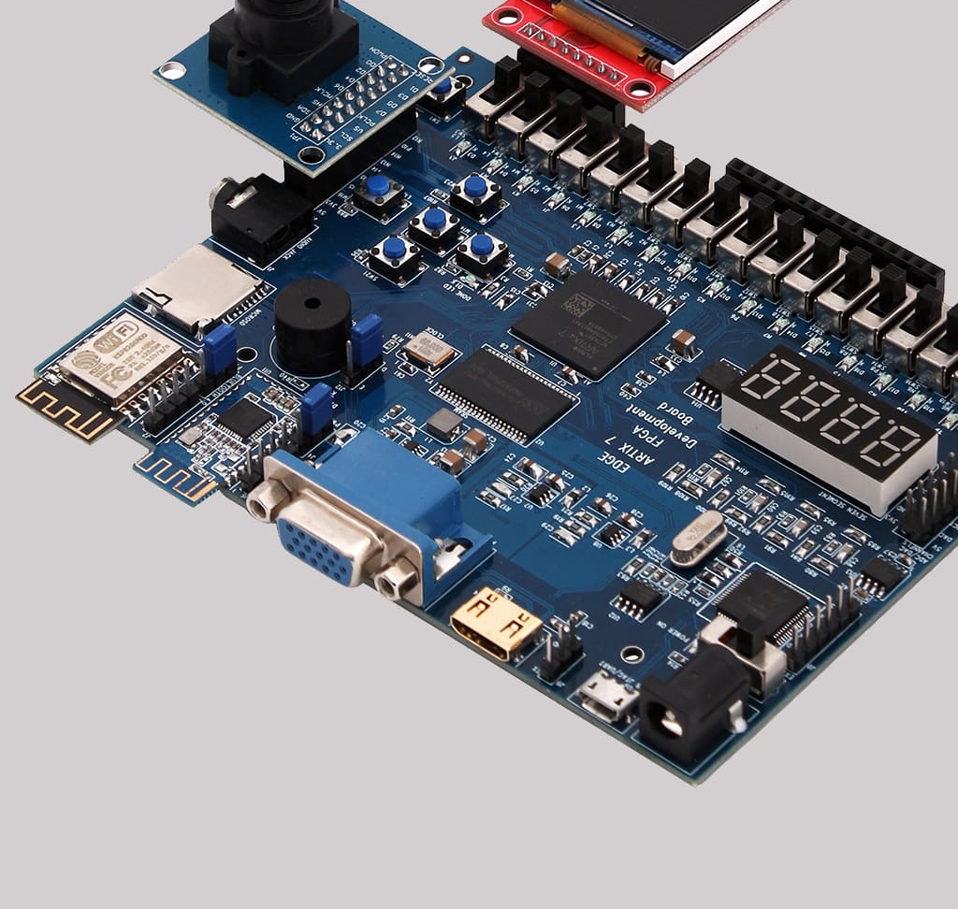
How to tackle the shortage of CPU advancement?
SmartNICs for
networks
Programmable SSDs for storage systems
GPUs for graphical computations
TPUs and FPGAs for miscellaneous tasks
IFIP Networking Conference 2022
Notes:
There are accelerators for various purposes that we can exploit for additional computation.

Slide 6
SmartNICs as additional computation resource
SmartNICs for
networks
Programmable SSDs for storage systems
GPUs for graphical computations
TPUs and FPGAs for miscellaneous tasks
IFIP Networking Conference 2022
Notes:
There are accelerators for various purposes that we can exploit for additional computation.

Slide 7
Computing ability of SmartNICs
‌Benchmark using roofline
Device | Specs | GFLOP/s
CPU (x86) | Xeon(R) Silver 4210R CPU 2.4GHz, 10 cores | 91.0
SmartNIC (ARM) | NVIDIA BlueField (ARMv8 A72, 800 MHz, 16 cores) | 17.6
SmartNIC can add 18% computing support.
Also, there can be multiple SmartNICs per server (E3 USENIX’19).
IFIP Networking Conference 2022

Slide 8
Load balancing approach
Existing LBs work at a per-server granularity —> The performance is affected drastically because accelerators have
limited resources
different architectures
There is a need for an LB that operates at a finer granularity —> We introduce per-accelerator granularity in the proposed LB system.
IFIP Networking Conference 2022

Slide 9
Load balancer deployment
On servers or accelerators
Usually, run along with other applications
On programmable switches
Process packets at line rates
Servers and their accelerators can use their resources for other applications
IFIP Networking Conference 2022

Slide 10
Our proposed solution: P4Mite
A Load Balancer which:
Works at a per-accelerator granularity
Challenge #1: It must run a heterogeneous environment
How to address? The system collects resource statistics from hosts AND their accelerators and then distributes the load
Runs on a programmable switch
Challenge #2: It must handle many connections using negligible memory footprint
How to address? It stores compressed information inside the switch
IFIP Networking Conference 2022

Slide 11
Background and State-of-the-art

Slide 12
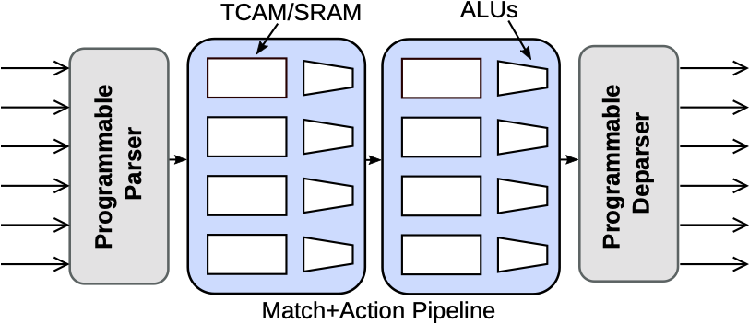
Data Plane Programming
Protocol Independent Switch Architecture (PISA)
Parses packets
Performs a set of match+action rules on packets
Deparses packets
Works at line-rates
Can work on every packet if needed
IFIP Networking Conference 2022

Slide 13
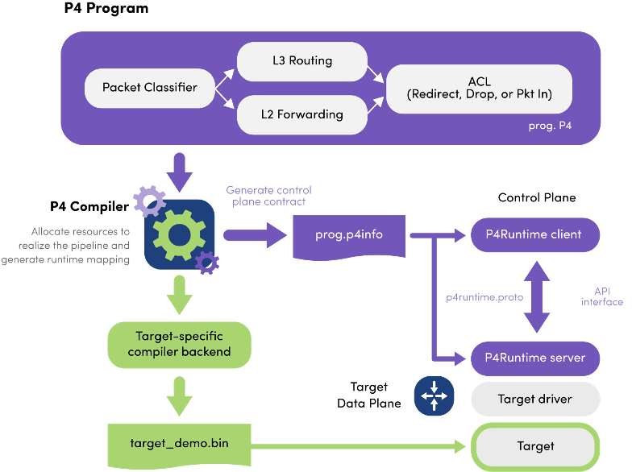
Programmable Switches
Programming Protocol-independent Packet Processors (P4) is a domain-specific language for data plane programming
We use the Tofino switch in this research (Tofino Native Architecture)
IFIP Networking Conference 2022
Source: p4.org

Slide 14


Existing Load Balancers
Load Balancer | Resource Awareness | Accelerator Visibility | Deployment
SilkRoad (SIGCOMM’17) |  |  | In a programmable switch
Loom (ICNP’21) |  |  | In a programmable switch
Cheetah (USENIX’20) |  |  | In a programmable switch
Tiara (USENIX’22) |  |  | In a switch + SmartNIC + server
CrossRSS (CoNEXT’20) |  |  | In a SmartNIC
Charon (CNSM’21) |  |  | In a SmartNIC
P4Mite |  |  | In a programmable switch
IFIP Networking Conference 2022

Slide 15
Our contributions
P4Mite: an accelerator-aware in-network load balancer
Implemented a prototype of P4Mite
Evaluated P4Mite over different applications
IFIP Networking Conference 2022

Slide 16
P4Mite Design

Slide 17
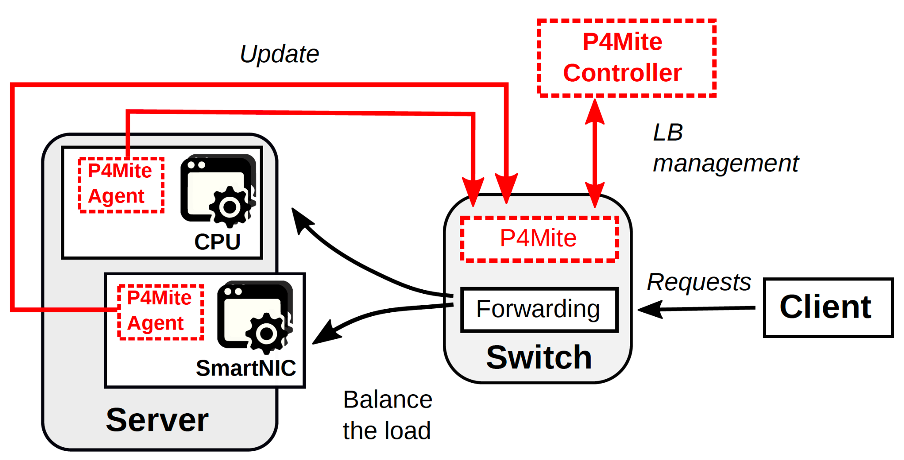
P4Mite system overview
The controller implements a policy and configures the associated switch
Its data plane processes requests accordingly
Agents actively monitor servers and accelerators and update the switch based on a target metric (CPU utilization, processing time, etc.)
IFIP Networking Conference 2022

Slide 18
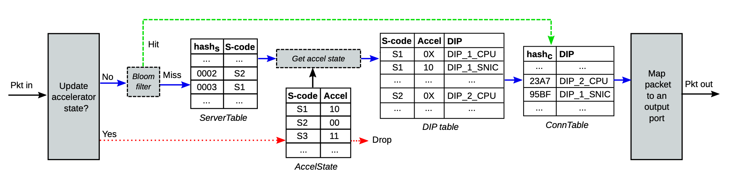
Data Plane Design
IFIP Networking Conference 2022

Slide 19
Data Plane Design
First, the switch checks the type of packets: state vs. request
IFIP Networking Conference 2022

Slide 20
Data Plane Design
First, the switch checks the type of packets: state vs. request
Updates bitmaps from the AccelState table
IFIP Networking Conference 2022

Slide 21
Data Plane Design
First, the switch checks the type of packets: state vs. request
Computes hash for the bloom filter
Hits are from existing connections
Misses are from new connections
IFIP Networking Conference 2022

Slide 22
Data Plane Design
In the case of a new connection, the request is dispatched to a server using the ServerTable
IFIP Networking Conference 2022

Slide 23
Data Plane Design
In the case of a new connection, the request is dispatched to a server using the ServerTable
Next, it keeps checking the state of that server from the AccelState
IFIP Networking Conference 2022

Slide 24
Data Plane Design
In the case of a new connection, the request is dispatched to a server using the ServerTable
Next, it keeps checking the state of that server from the AccelState
Thirdly, it maps to the server’s CPU or an accelerator based on the DIP table
IFIP Networking Conference 2022

Slide 25
Data Plane Design
In the case of a new connection, the request is dispatched to a server using the ServerTable
Next, it keeps checking the state of that server from the AccelState
Thirdly, it maps to the server’s CPU or an accelerator based on the DIP table
Finally, the destination is stored in the ConnTable for subsequent packets
IFIP Networking Conference 2022

Slide 26
Data Plane Design
In the case of an existing connection, the destination is available in the ConnTable
IFIP Networking Conference 2022

Slide 27
P4Mite Implementation and Evaluation

Slide 28

Implementation
P4Mite Switch and Controller: Python3 and P4-16
Programmable switch: Intel Tofino
Hash Function: CRC16
Agents: Python3
Monitoring metric: Processing Time
https://github.com/PINetDalhousie/p4mite
IFIP Networking Conference 2022

Slide 29
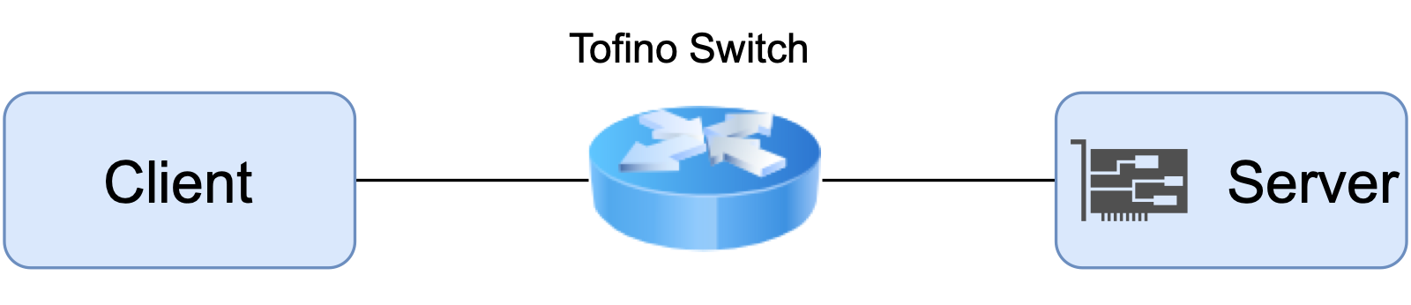
Evaluation Setup
Switch: Wedge 100BF-32X 32-port programmable switch with a 3.2Tbps Tofino ASIC
Server and client: Intel(R) Xeon(R) Silver 4210R CPU @ 2.4GHz with 10 cores and 32GB memory
SmartNIC: Dual-port SFP28, PCIe Gen3.0/4.0 x8
IFIP Networking Conference 2022

Slide 30
Experiment 1: A synthetic workload
A synthetic workload is implemented
The server application: performs different amounts of floating-point operations upon receiving a request
The client application: sends different numbers of requests per second (RPS)
Two parameter are evaluated in this experiment:
Request rate
Request size
Three processing time thresholds are tested (300ms, 1000ms, and 2000ms)
IFIP Networking Conference 2022

Slide 31
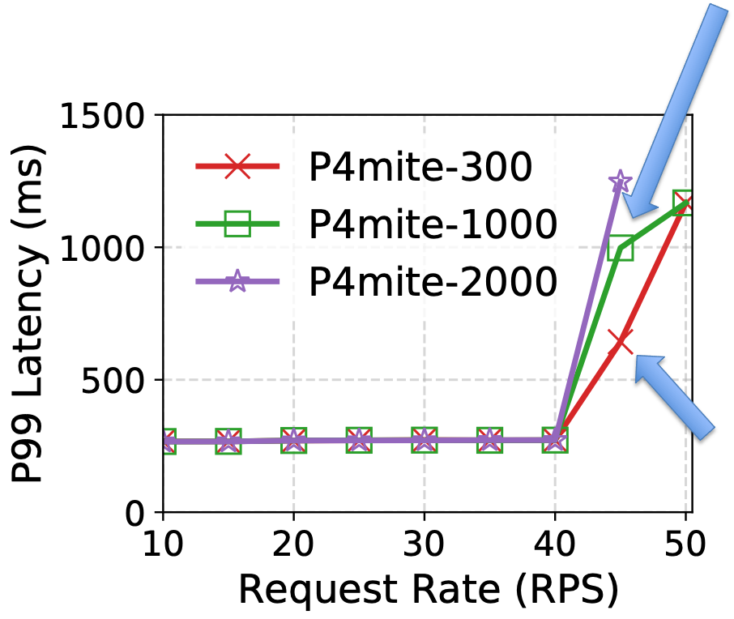
Exp1- evaluating request rate
The request size is set to 2 Gflop
All options work similarly up to 40 RPS
P4mite-300 and P4mite-1000 react at 45 RPS
P4mite-300 is the fastest one as its agent gets triggered quicker
IFIP Networking Conference 2022

Slide 32
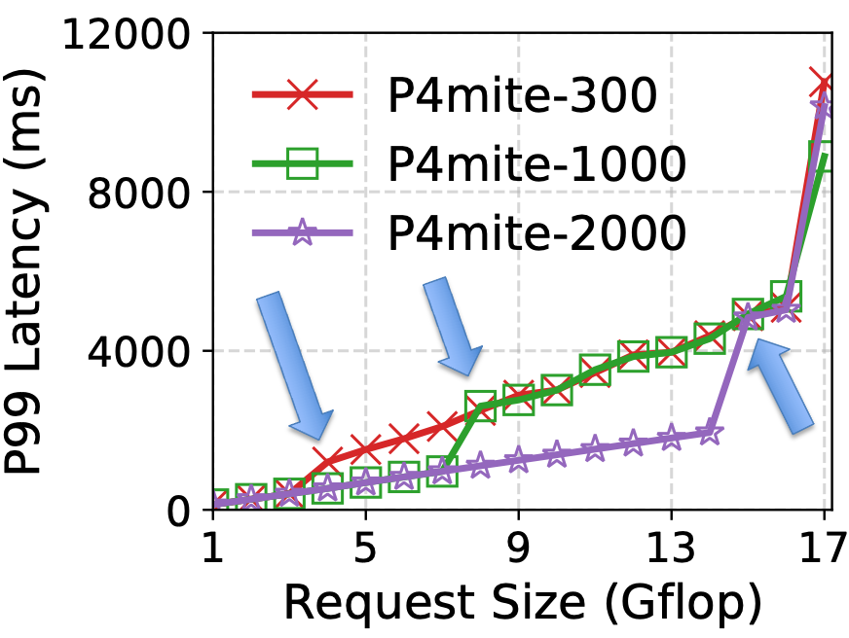
Exp1- evaluating request size
The request rate is set to 5 RPS
All options work similarly up to 4 Gflop
The agent of P4mite-300, P4mite-1000, and P4mite-2000 get triggered at size 4, 8, and 15 Gflop, respectively.
IFIP Networking Conference 2022

Slide 33
Experiment 2: Three Real-world applications
Three applications are implemented and tested separately
DNS
VGG16
KNN*
We compared P4Mite with two existing load balancing algorithms:
Equal-cost multi-path routing (EMCP): splits load evenly
Weighted Round Robin (WRR): The server and SmartNIC handle 5/6 and 1/6 of the load, respectively. These ratios are used according to the roofline’s results.
We configured a suitable threshold on the agents for each application
IFIP Networking Conference 2022
*KNN results are available in the full text

Slide 34
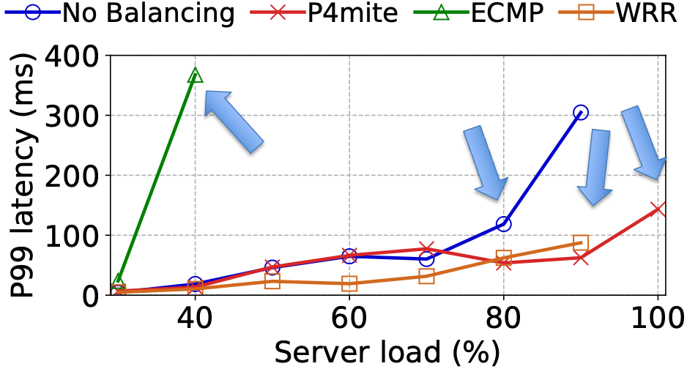
Exp2- DNS
It is a lightweight application
No balancing (baseline): latency increases after 80% load
ECMP: fully utilizes its SmartNIC at 40% load
WRR: proactively splits the load and can reach 90% load
P4Mite: handles 100% load and reduces the latency up to 50%
IFIP Networking Conference 2022

Slide 35
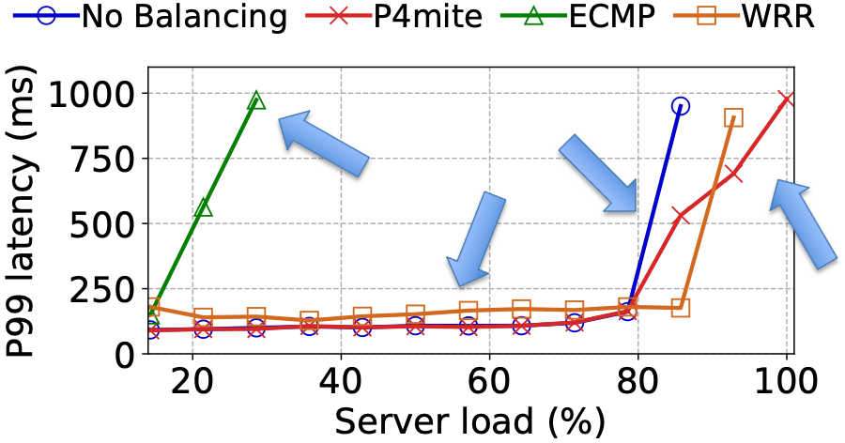
Exp2- VGG16
It is computationally heavier than DNS
Server’s latency: 80ms
SmartNIC’s latency: 120ms
Baseline: latency increases after 80% load
ECMP: fully utilizes its SmartNIC at 30% load
WRR: performs worse than the baseline and P4mite until 80% load
P4mite: handles 100% load
IFIP Networking Conference 2022

Slide 36
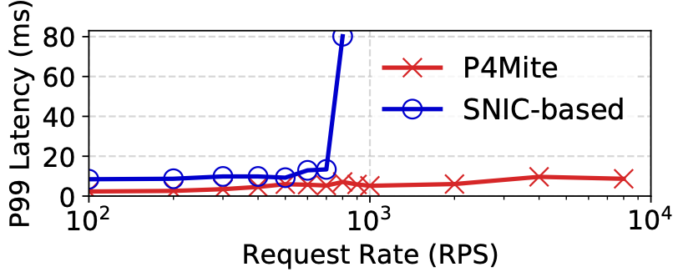
P4Mite overhead and Scalability
Agents: use less than 5% of CPU
P4Mite data plane: uses at most 6% resources (for 256 Servers, 2 accelerators on each, 50K connections)
IFIP Networking Conference 2022

Slide 37
Future Work
Implementing more advanced policies
Monitoring multiple metrics on servers and accelerator
Employing more powerful accelerators such as GPUs
Evaluating stateful applications
IFIP Networking Conference 2022

Slide 38
Conclusion
We introduced P4Mite, an accelerator-aware in-network load balancer
It offers per-accelerator granularity
We implemented P4Mite on top of a Tofino switch and evaluated its performance over three real-world applications
It can reduce end-to-end communication latency by up to 50%
We shared the prototype implementation
IFIP Networking Conference 2022

Slide 39
Questions?
Hesam Tajbakhsh (hs762129@dal.ca)
Ricardo Parizotto (rparizotto@inf.ufrgs.br)
Miguel Neves (mg478789@dal.ca)
Alberto Schaeffer-Filho (alberto@inf.ufrgs.br)
Israat Haque (israat@dal.ca)

